Slide 1

RIPHAH INTERNATIONAL UNIVERSITY SCHOOL OF COMPUTING AND INNOVATION (RSCI)
GRAPHICAL REPRESENTATION OF SINE, COSINE AND TANGENT GRAPH USING GRAPHICS

Slide 2
PROJECT INFORMATION
Project Name: Graphical Representation of Sin, Tan and Cos graph.
Group Members: Husnain Momin and Imran

Slide 3
Introduction
It is a program which asks user for an input angle using the already given values or the user can enter his own. It then converts the angle into radians and draw its respective graph using graphics library.

Slide 4
Some Functions
Calculate Factorial.
Convert angles into radians.
Use Taylor series to calculate sin, cos and tan.
A user can enter their own or predefined value.
Pointers to output values.

Slide 5
IDE and Programming language used
The programming language used is C++ and the IDE used is Dev C++.
The key library in this program is graphics.h.

Slide 6
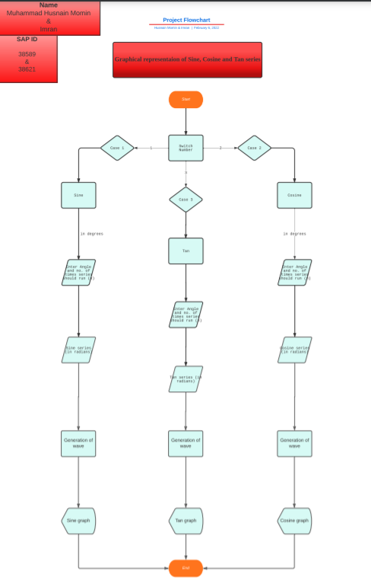
FLOW CHART

Slide 7
Conclusion
You can get a trigonometric graph of any value of Sin, Cos and Tan on windows BGI using graphics.h.
It creates a horizontal line similar to the x axis on a Cartesian plane using getmax function

